Slide 1

Hyperparameters tuning
Hyperparameters
tuning in practice:
Pandas vs. Caviar
deeplearning.ai

Slide 2


Re-test hyperparameters occasionally
Idea
NLP, Vision, Speech,
Ads, logistics, ….
Intuitions do get stale. Re-evaluate occasionally.
Experiment
Code

Slide 3
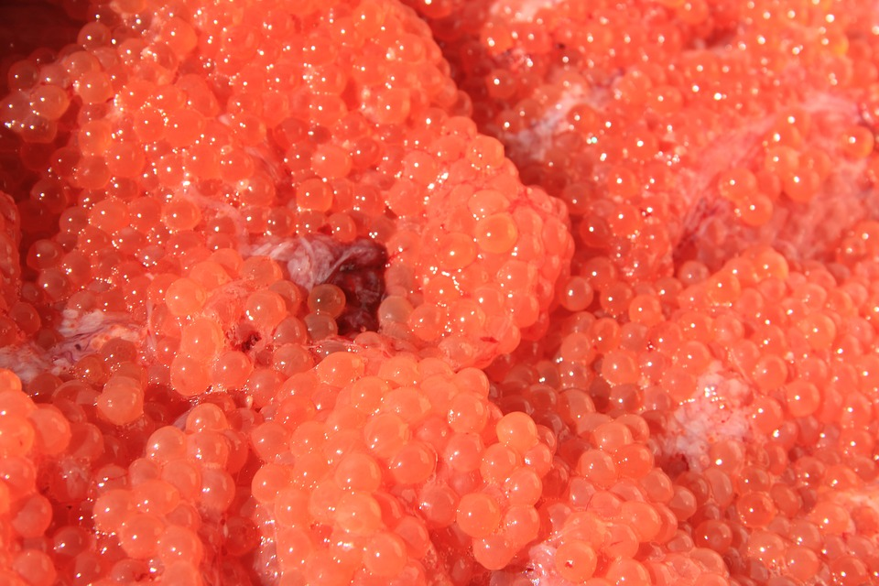
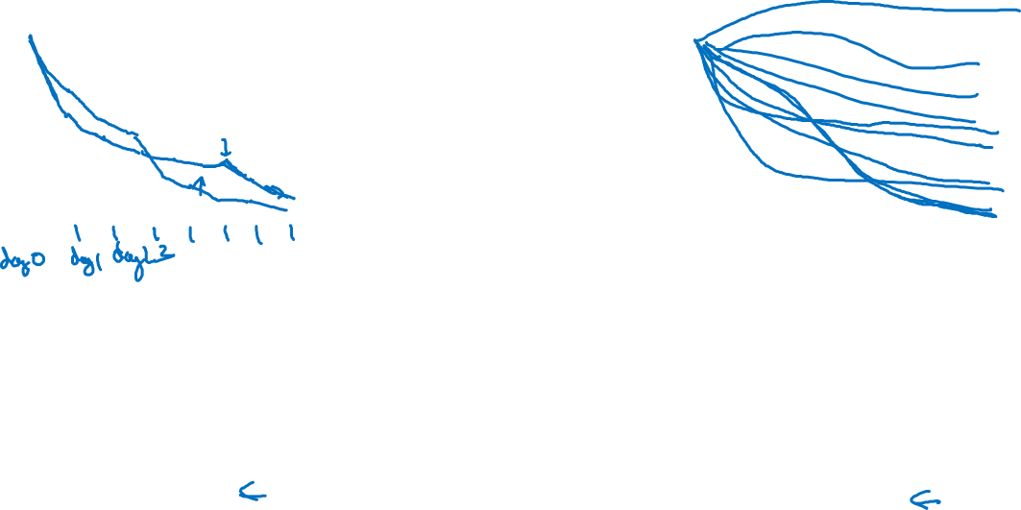
Babysitting one model
Training many models in parallel
Panda
Caviar

